Slide 1
Web Document Categorization using Machine Learning Techniques.

Slide 2
Motivation
Due to Large size of web document it is often difficult to categorize them into respective category (whether document is of type Sports, Politics, Business, etc.,)
Machine learning techniques have achieved amazing success in modelling large-scale data recently. It has shown powerful learning ability that even outperforms human to some extent and these techniques have been demonstrated to be very effective to categorize web documents. The success of Machine Learning techniques motivates us to explore its potential application in our context.

Slide 3
Document Categorization
Data Pre processing-
Tokenization – Eliminates the punctuation signs in the text.
Stopping – Remove stopping words. Example:- articles ,modal verb , preposition, etc.,
Stemming – Reduction of each term to own lexical root using Porters ,Snowball Algorithm.
4. Scoring.

Slide 4
Support Vector Machine
“Support Vector Machine” (SVM) is a supervised machine learning algorithm which can be used for both classification or regression challenges. However, it is mostly used in classification problems. In this algorithm, we plot each data item as a point in n-dimensional space (where n is number of features you have) with the value of each feature being the value of a particular coordinate. Then, we perform classification by finding the hyper-plane that differentiate the two classes very well

Slide 5
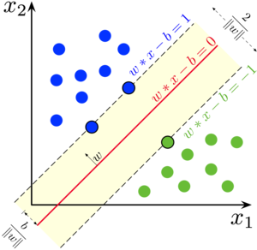
SUPPORT VECTOR MACHINE

Slide 6
Random Forest Algorithm
Random forests or random decision forests are an ensemble learning method for regression and other tasks that operates by constructing a multitude of decision trees at training time and outputting the class that is the mode of the classes (classification) or mean prediction (regression) of the individual trees. Random decision forests correct for decision trees habit of overfitting to their training set.

Slide 7
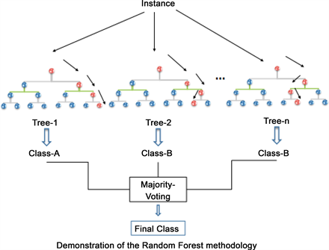
Random Forest Algorithm

Slide 8


Technology Stack
Python Interpreter(3.7) – Anaconda Spyder.
Sci-Kit Learn Library.
BBC-news dataset.

Slide 9
Implementation and Result
Machine Learning models were implemented in python using Scikit-Learn library.
80% of total dataset was considered for training purpose while rest 20% was considered as test dataset. The model was trained against 80% of dataset. The expected result (Fig. 3) for sample of dataset and the result predicted by Random Forest algorithm (Fig. 4) can be shown as below. Overall accuracy of 96.17% can be achieved using Random Forest Algorithm and 97.30 % accurate results can be obtained using Support Vector Machine for dataset of size 2225 documents.

Slide 10
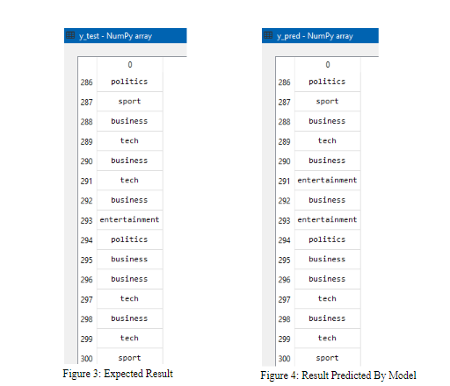

Slide 11
Performance Evaluation
For a given dataset of size 2225 articles SVM achieves accuracy of 97.3%.
Linear Kernel and Gamma value of 30 gives this accuracy.
Random Forest Algorithm gives an overall efficiency of 96.40%.
Confusion Matrix for Random Forest Algorithm:-
[[113 0 2 0 0]
[ 2 68 1 1 0]
[ 2 0 72 1 1]
[ 1 0 0 101 0]
[ 3 1 0 1 75]]

Slide 12
Challenges
Data Pre processing:
Data pre processing was one of the major challenges. Removal of stopping words, process of stemming ,removal of punctuation marks and other pre processing was needed to be carried out.
Needs large dataset:
As every Machine learning problem this problem also requires large amount of dataset. It was a daunting task to find dataset. Fortunately for this problem statement BBC news dataset could be found from online resources
Analysis of appropriate kernel and gamma value:
For best fit, that is to decide hyperplane there was need to decide appropriate Kernel and Gamma value. During iterative implementation it was found that linear kernel and gamma value of 30 showed efficient result.

Slide 13
Conclusion
Using off-the-shelf tools and simple models, complex task can be solved, that of document classification, which might have seemed daunting at first! To do so, we followed steps common to solving any task with machine learning:
Load and pre-process data.
Analyse patterns in data.
Train different models, and rigorously evaluate each of them.
Interpret the trained model.

Slide 14
Future Enhancements
Although results are satisfactory there are big scope for improvement.
Training on large dataset can improve accuracy and model can be generalized.
Data loss can be minimized using more efficient architecture.

Slide 15
Thank You!!

